Slide 1
BUSINESS ANALYTICS
UNIT II
FINANCIAL & OPERATIONAL ANALYTICS
Dr.ASHOKAN.C
B.Sc;MBA;NET;M.Phil;PhD;AMT;FDP(IIM-A)

Slide 2
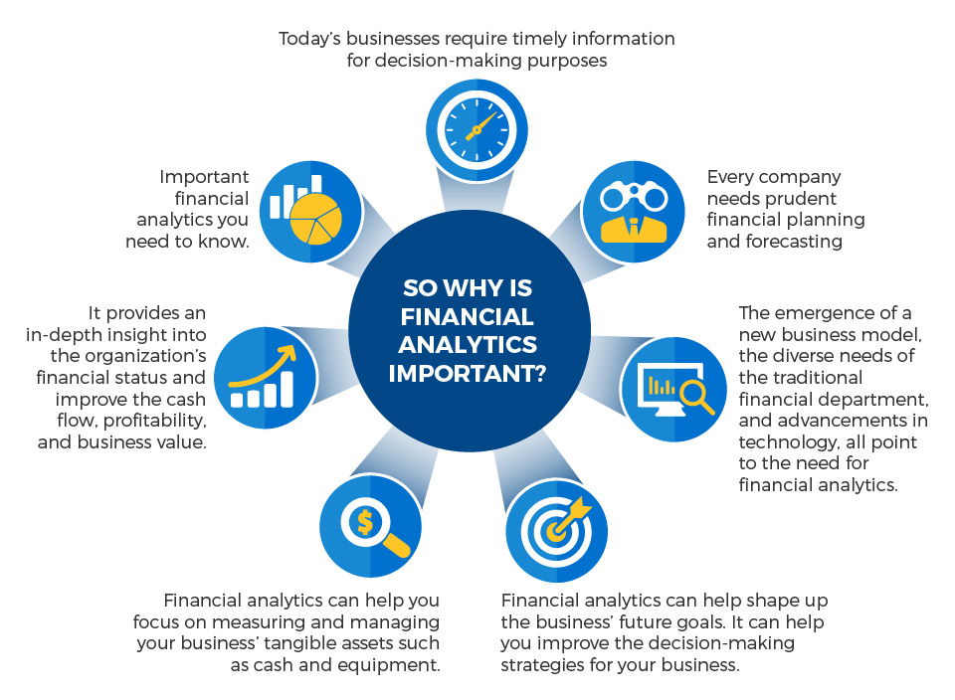
FINANCIAL ANALYTICS

Slide 3
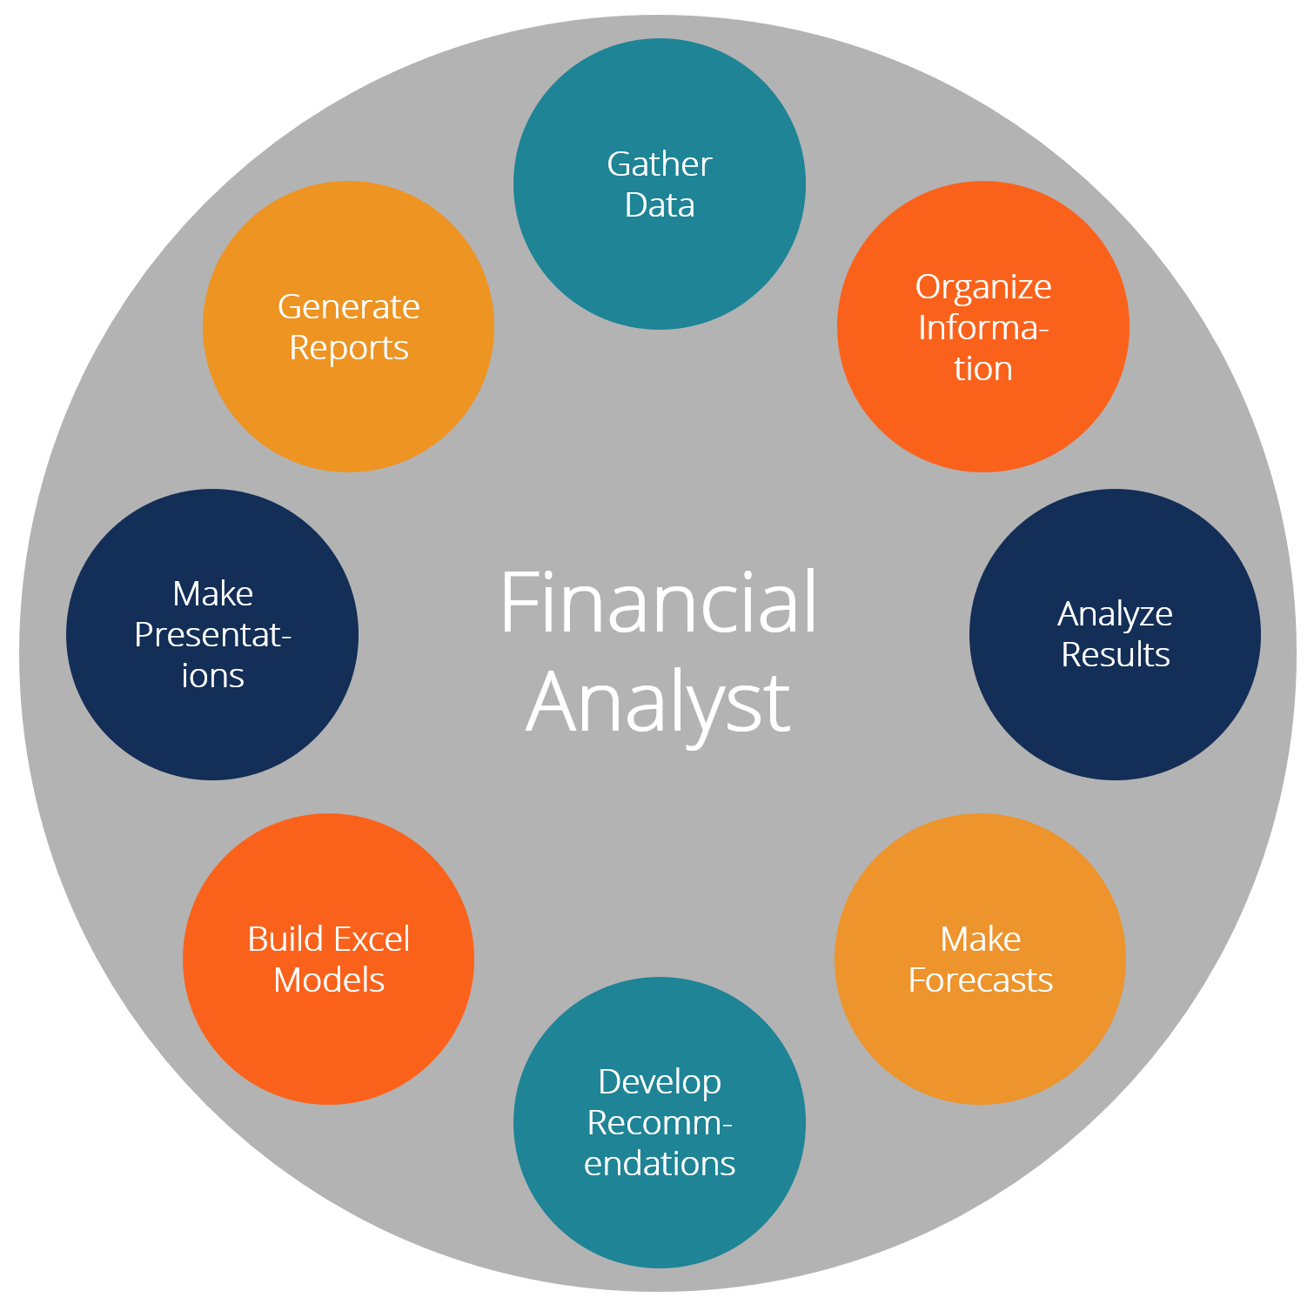

Slide 4
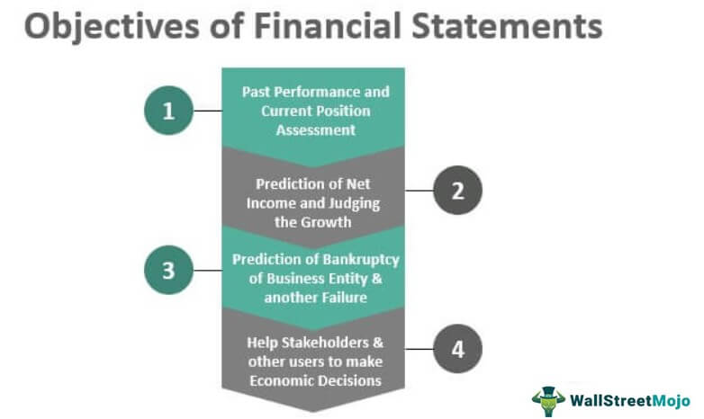
Objectives of Financial Analytics

Slide 5
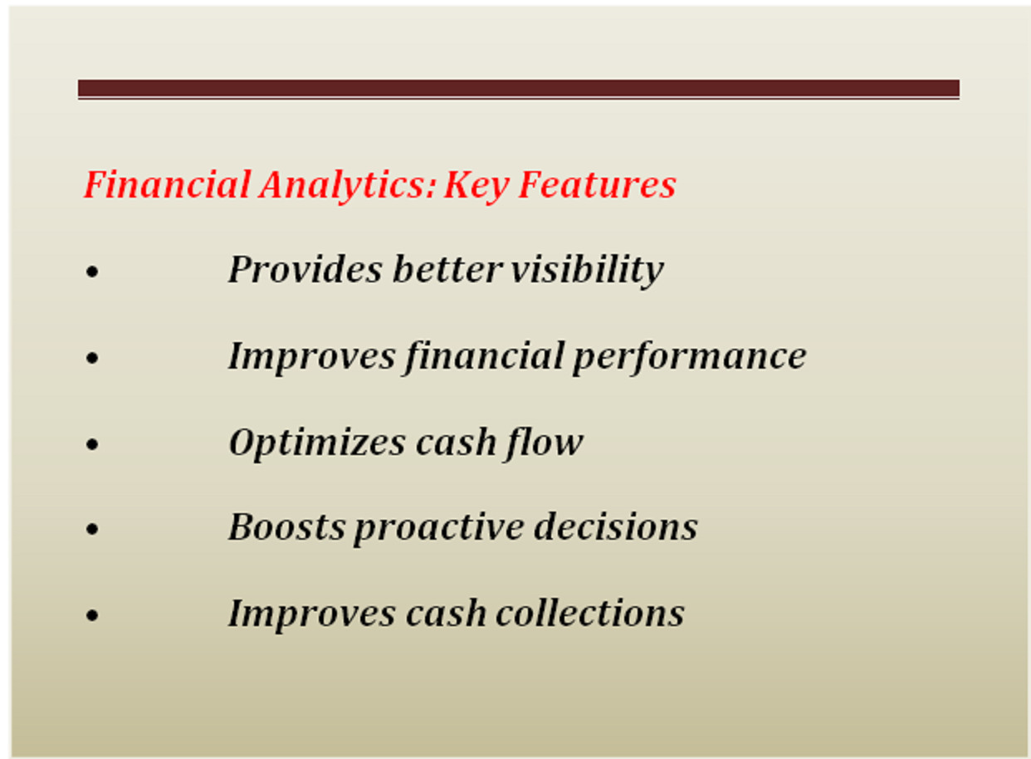

Slide 6
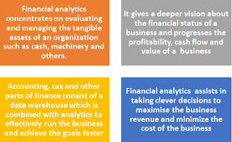

Slide 7
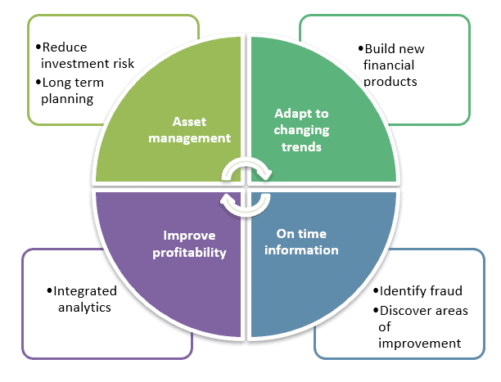
Uses of Financial Analytics

Slide 8
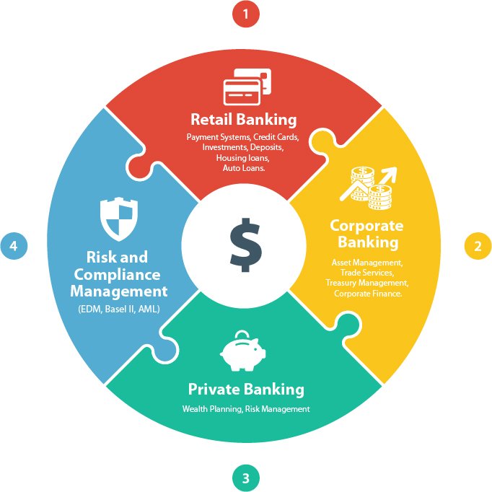

Slide 9
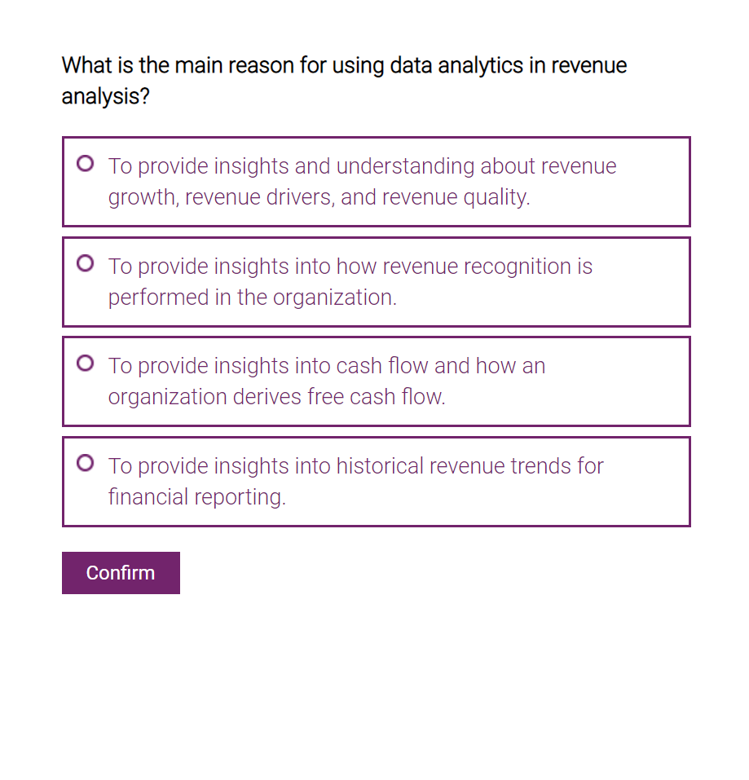
Reasons for using financial analytics

Slide 10
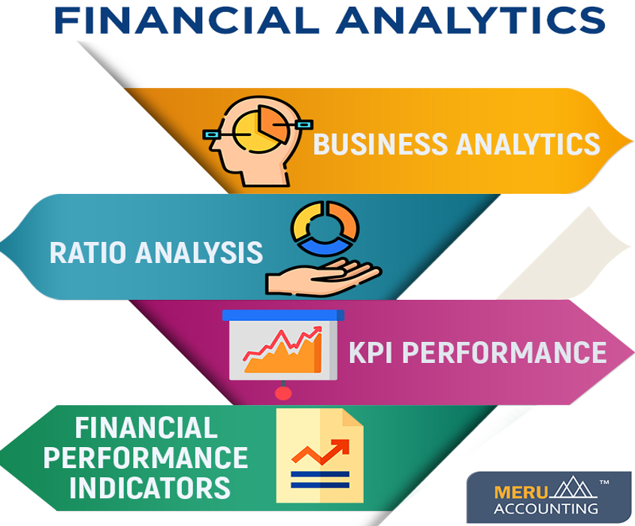
Importance of Financial Analytics

Slide 11
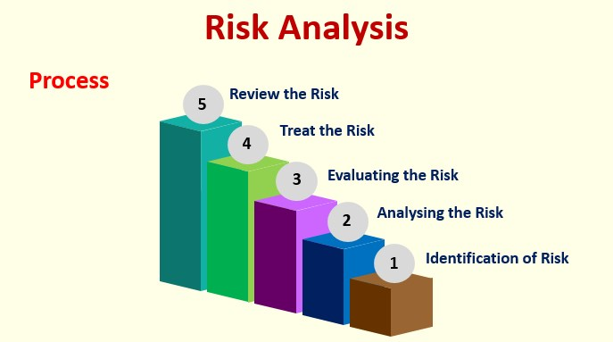
Risk & Risk Analytics

Slide 12
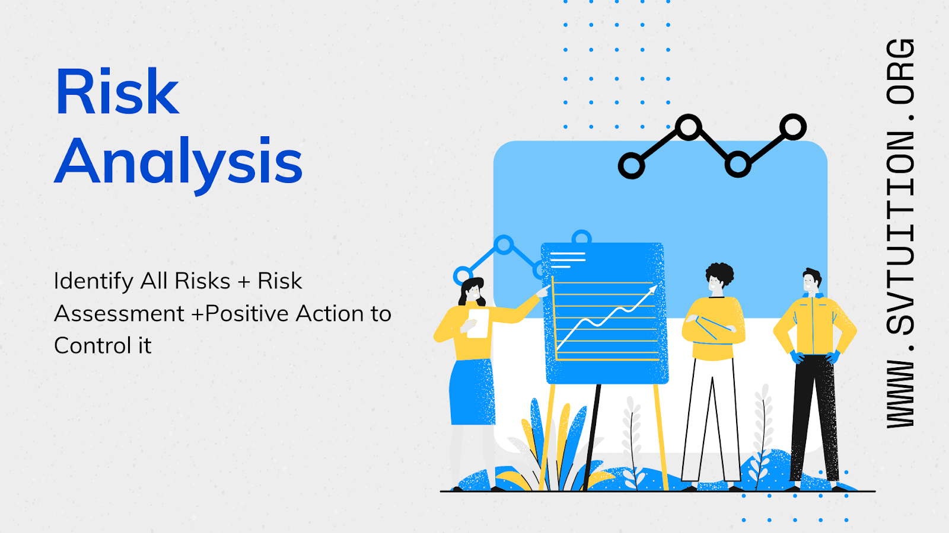

Slide 13
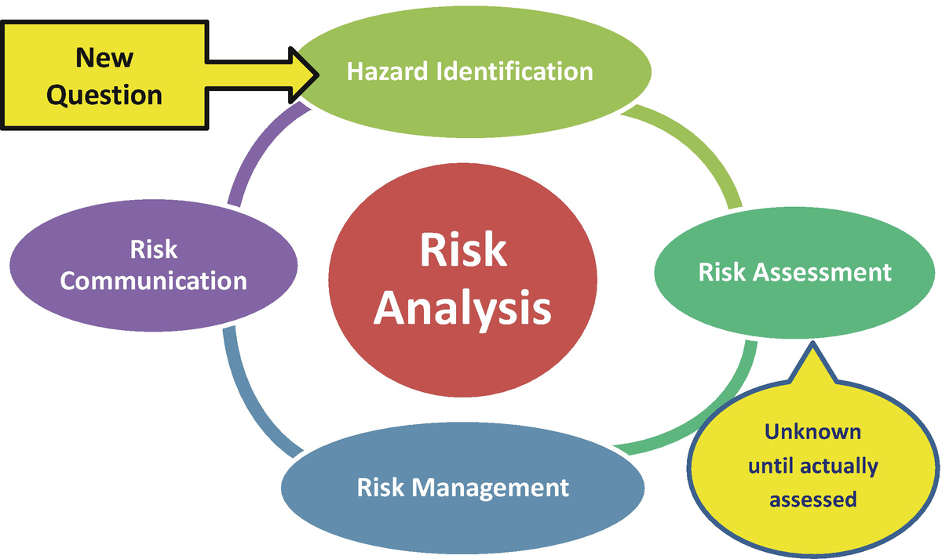

Slide 14
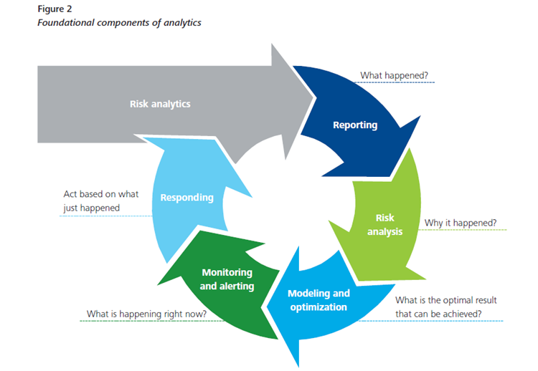

Slide 15
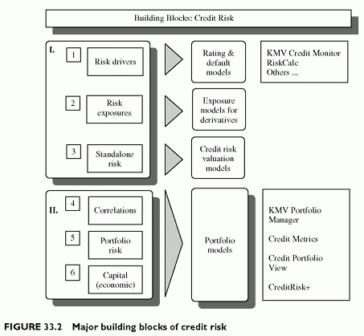

Slide 16
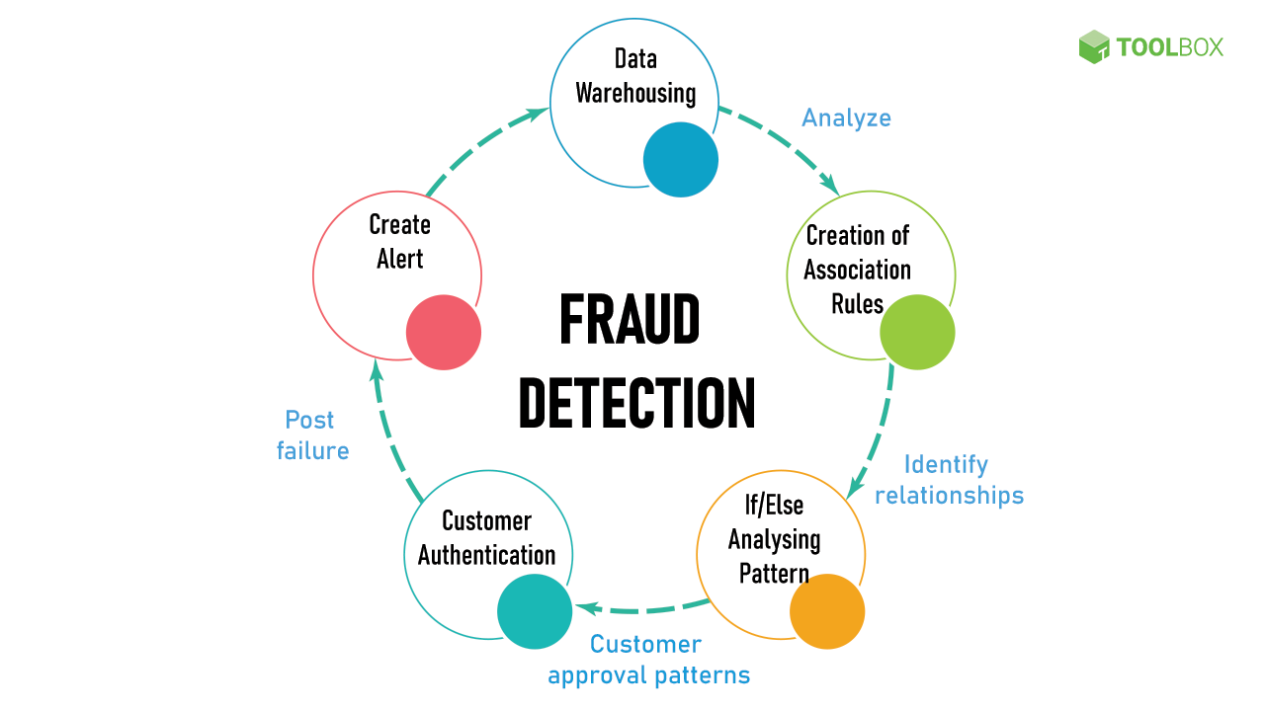
Fraud Detection, Prevention and Analytics

Slide 17
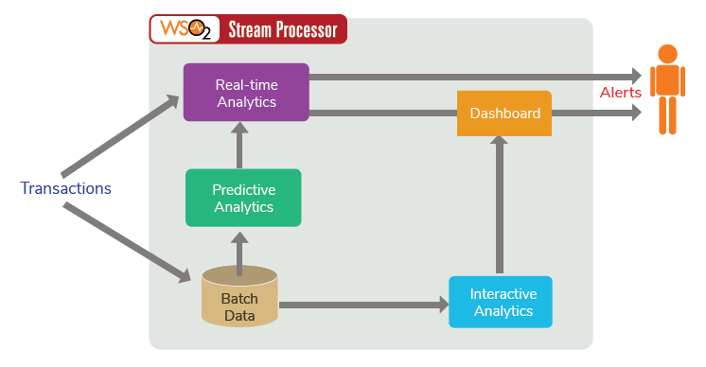

Slide 18
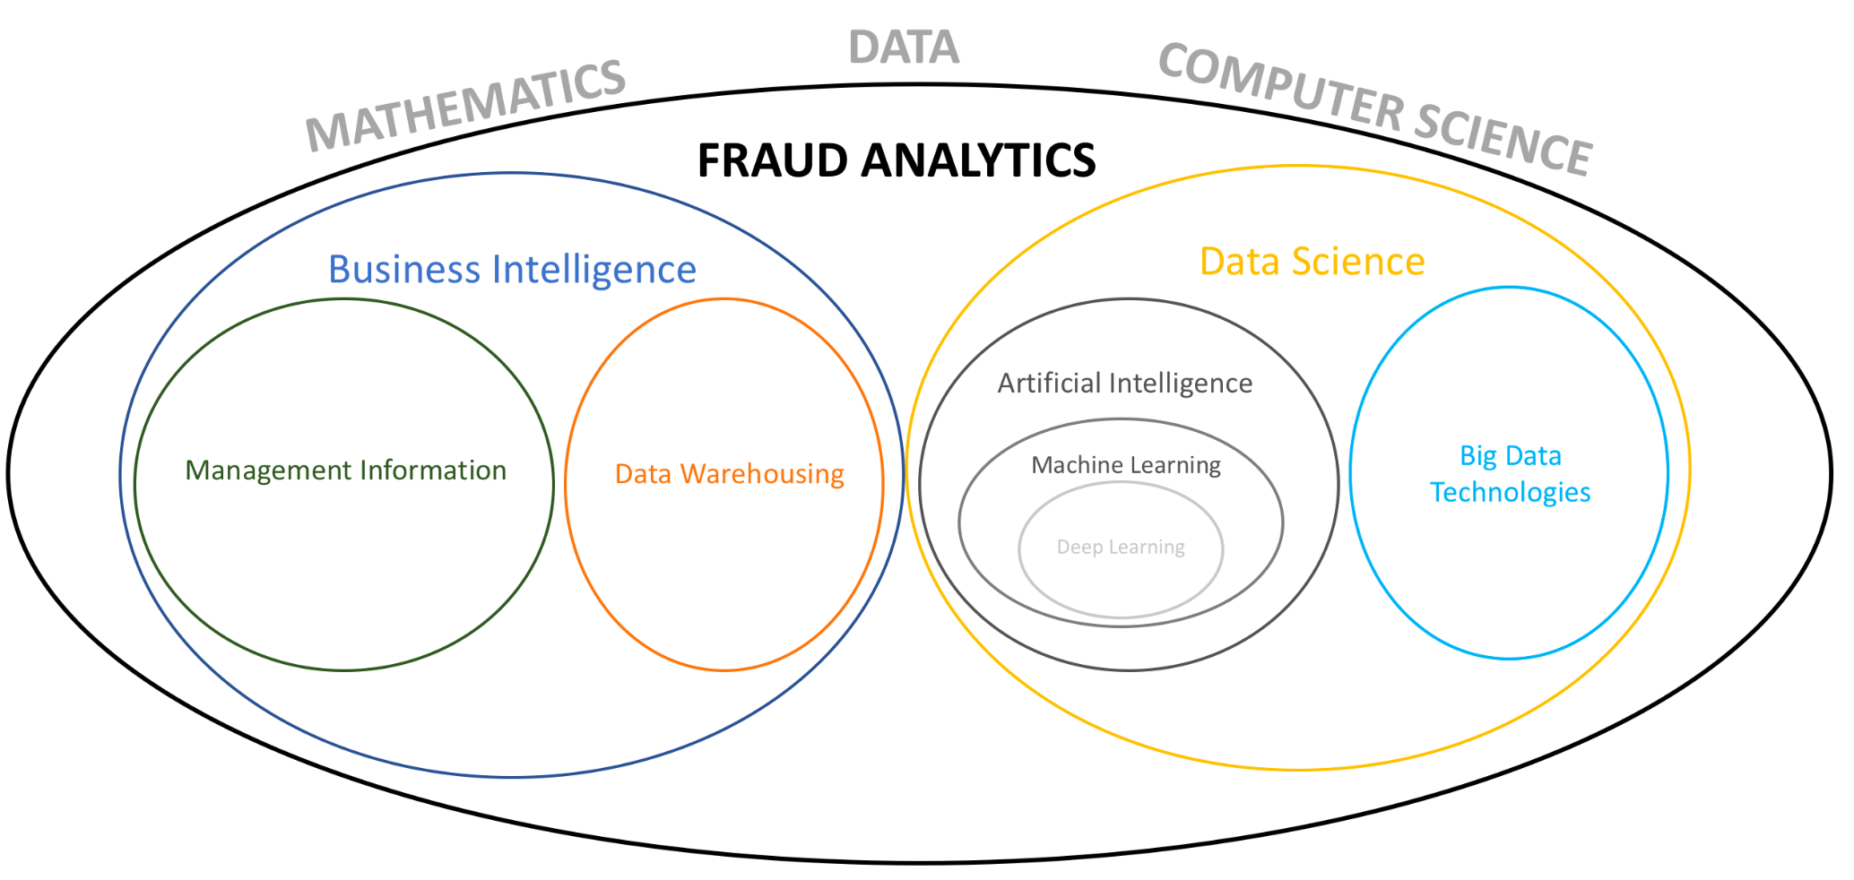

Slide 19
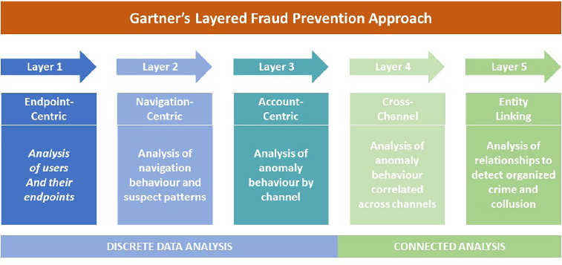

Slide 20
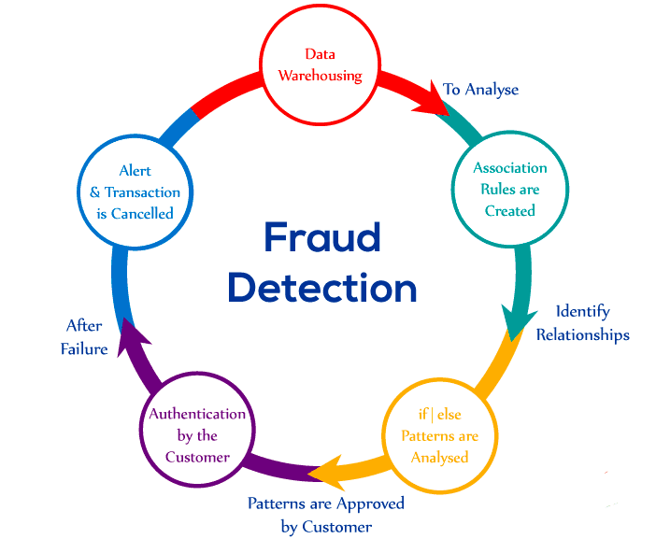
Methods of fraud detection

Slide 21
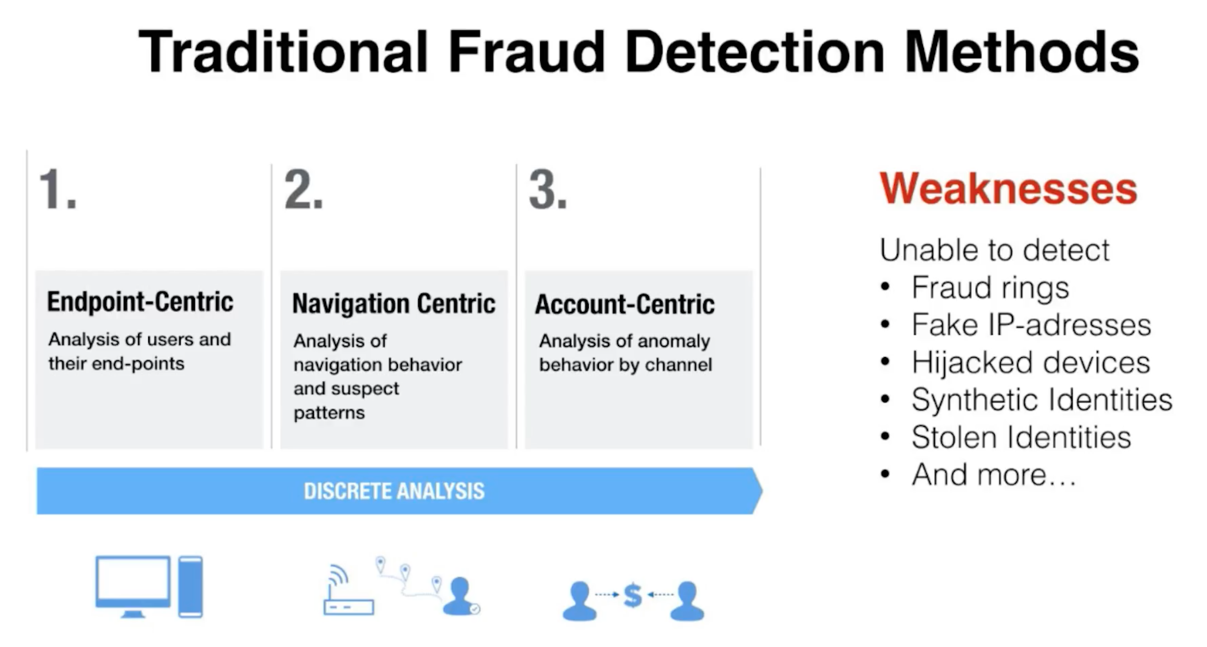

Slide 22
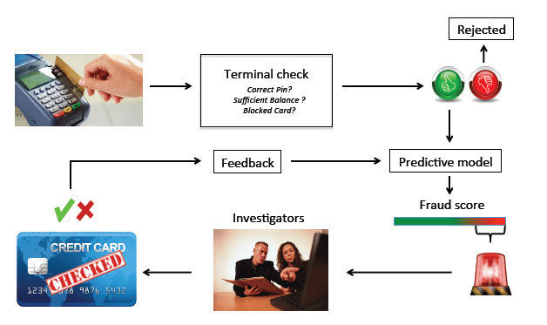
Steps of fraud detection

Slide 23
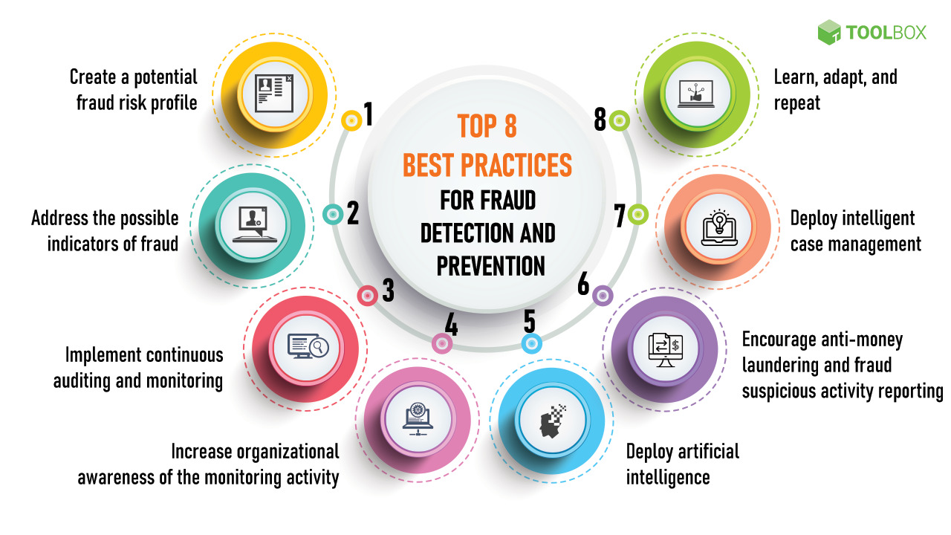

Slide 24
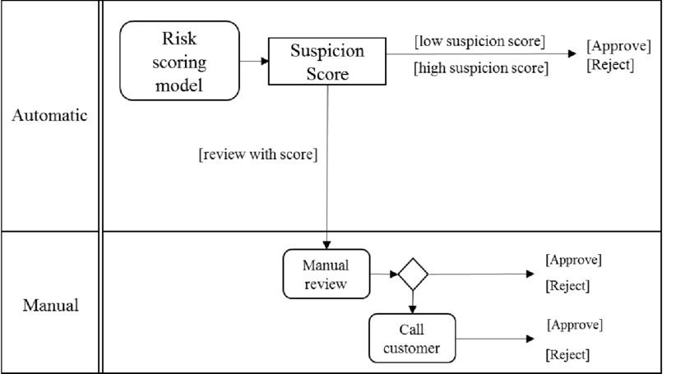
Steps of fraud detection

Slide 25
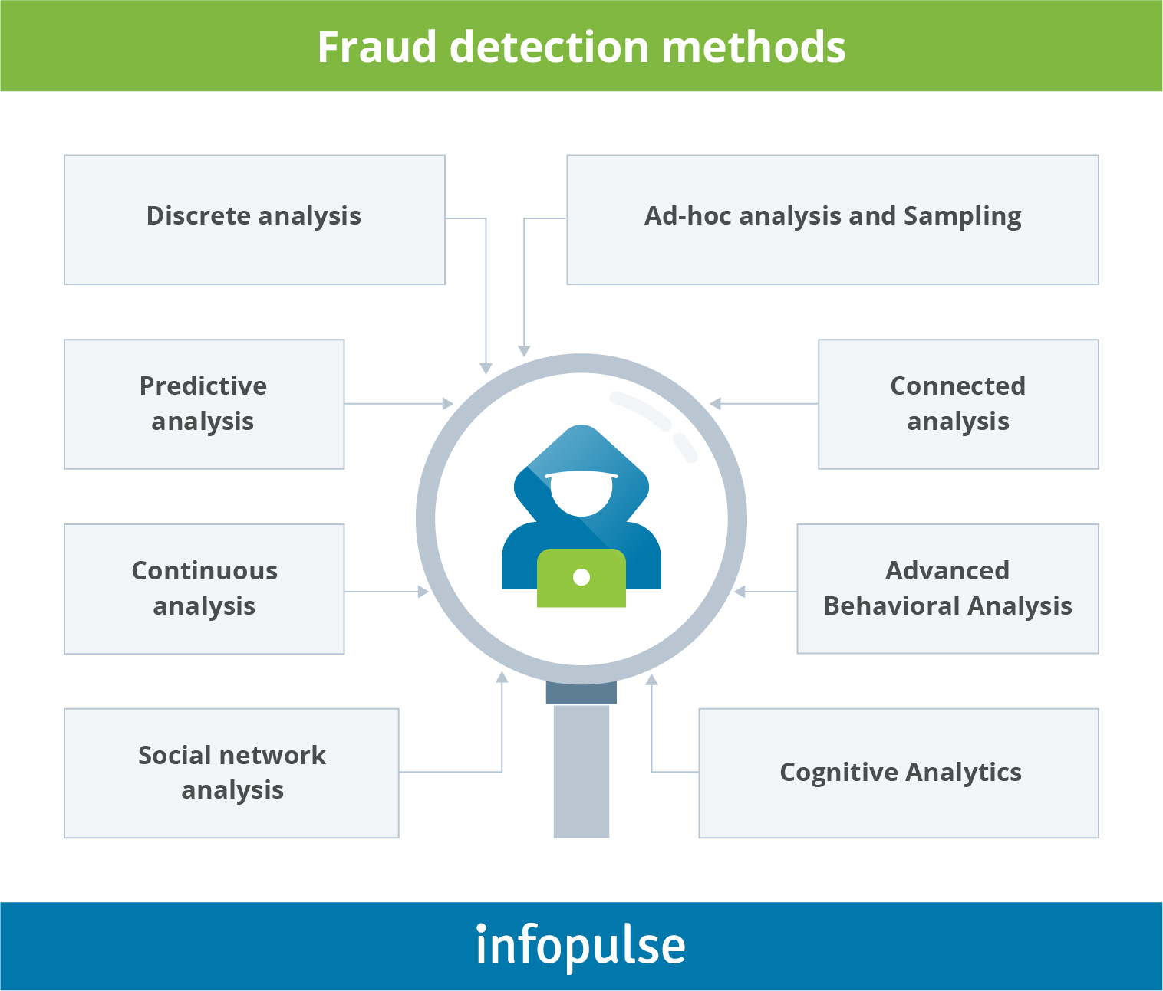
Methods of fraud prevention

Slide 26
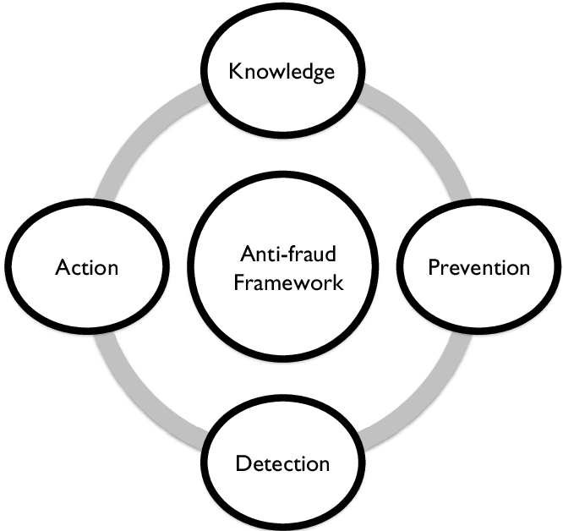

Slide 27
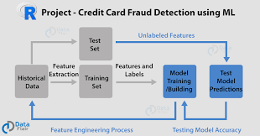
Process model of fraud analytics

Slide 28
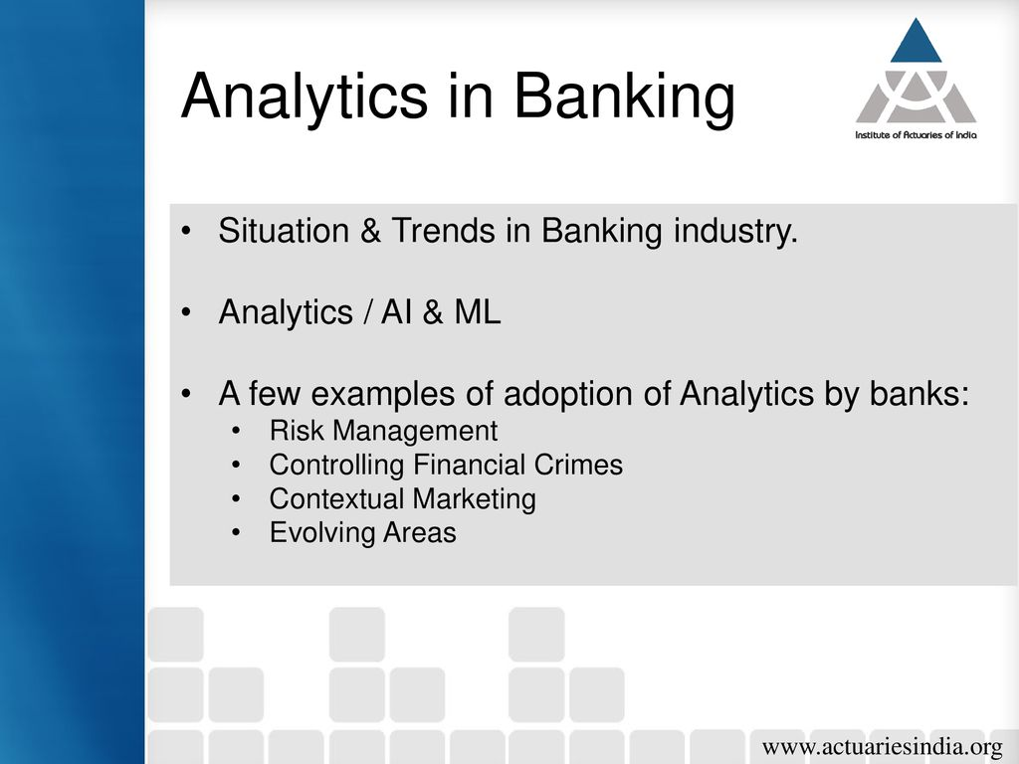

Slide 29
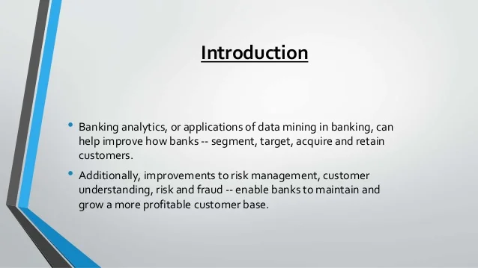

Slide 30
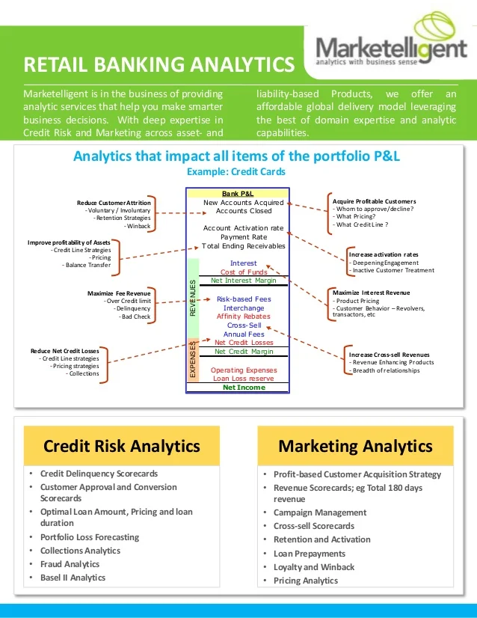
Analytics in Retail Banking

Slide 31
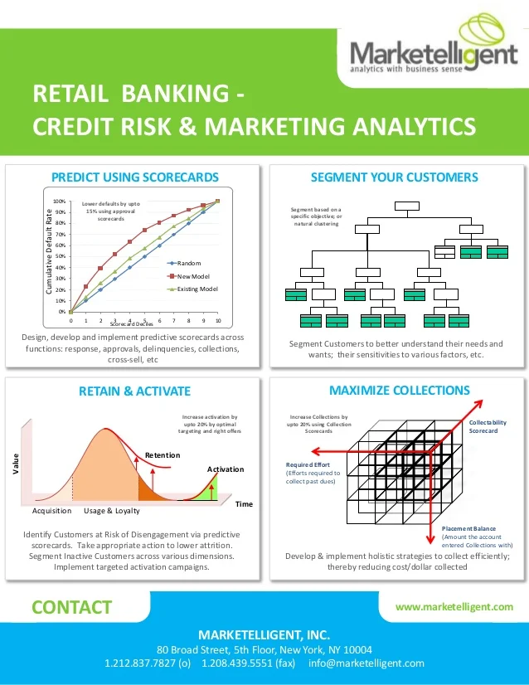

Slide 32
OPERATIONAL ANALYTICS
Dr.ASHOKAN CHANKARACHAN

Slide 33
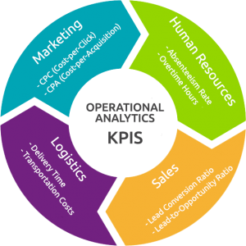

Slide 34
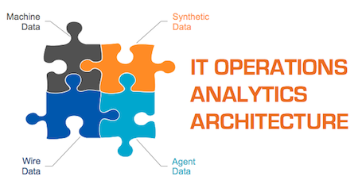

Slide 35
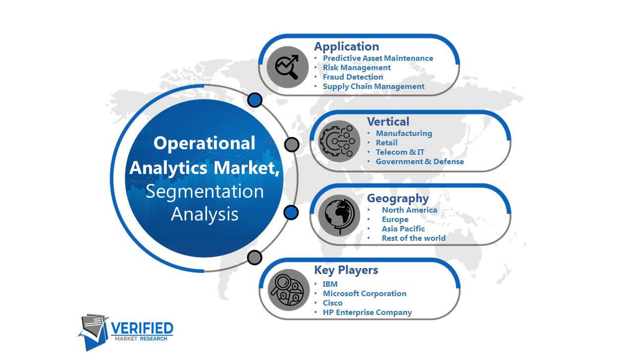

Slide 36
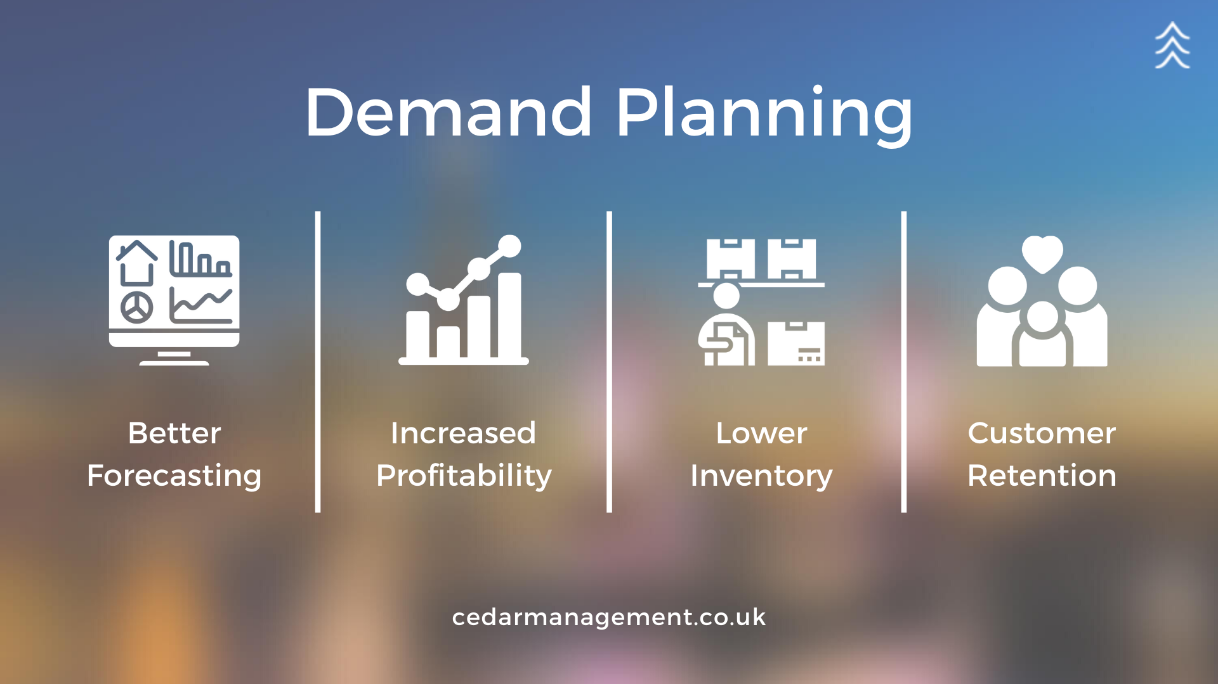
Demand Planning Analytics

Slide 37
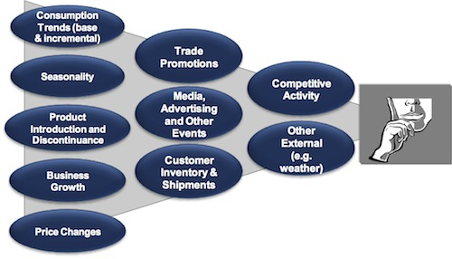

Slide 38
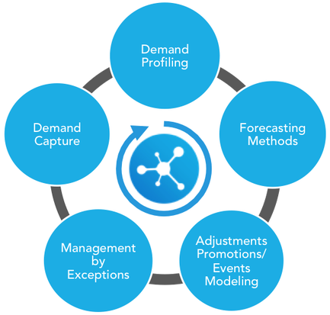

Slide 39
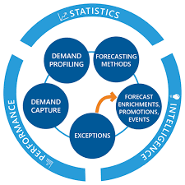

Slide 40
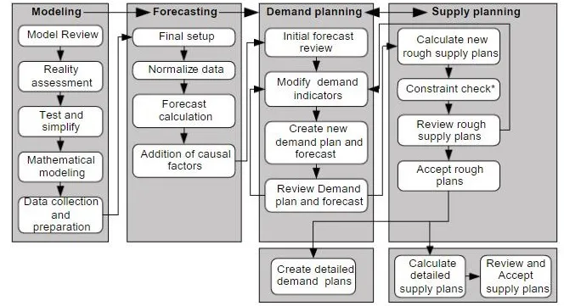

Slide 41
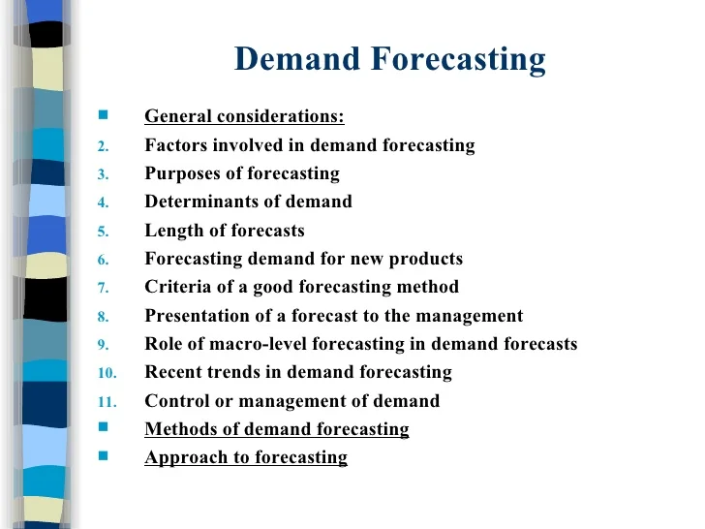
Demand Forecasting

Slide 42
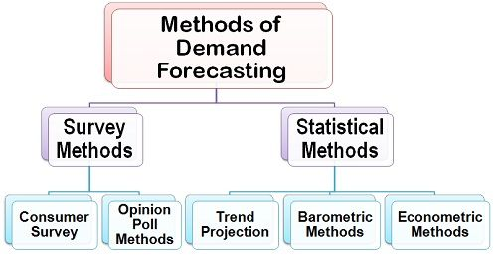

Slide 43
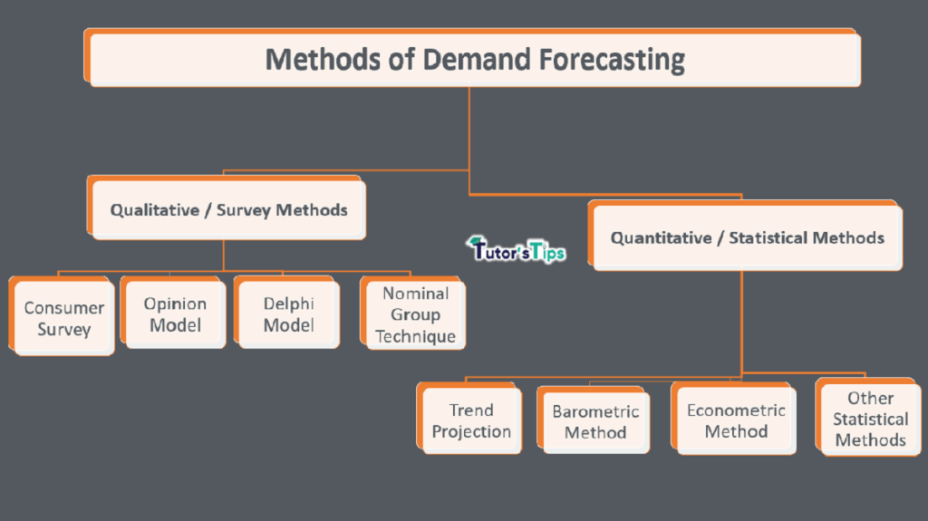

Slide 44
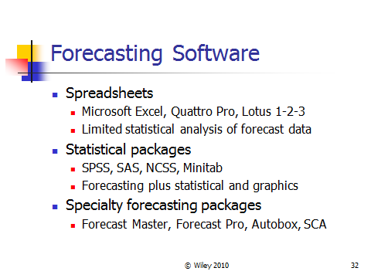
Software used for forecasting

Slide 45
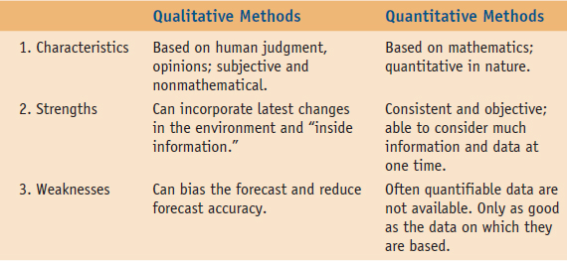
Difference between the two-

Slide 46
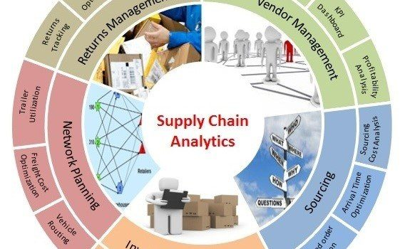
Supply Chain Analytics

Slide 47
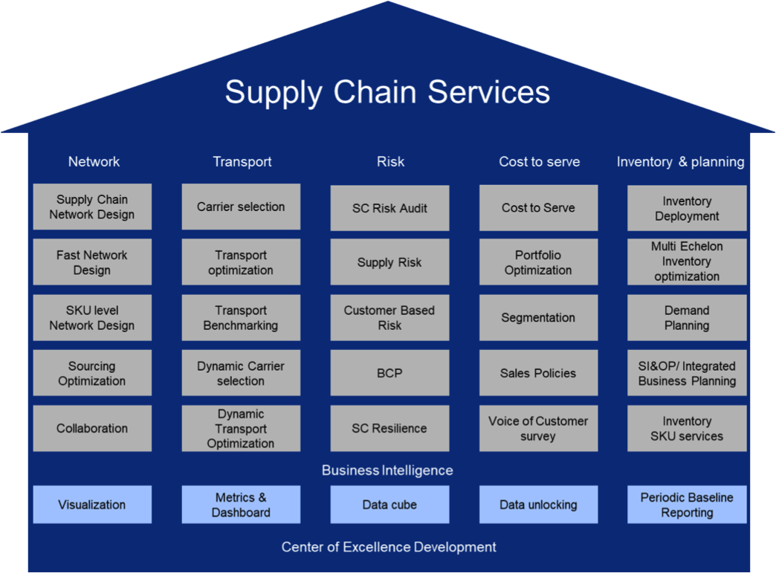

Slide 48
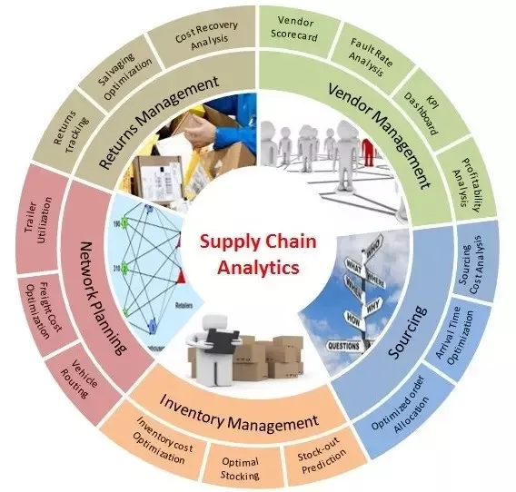
Objectives of Supply Chain Analytics

Slide 49
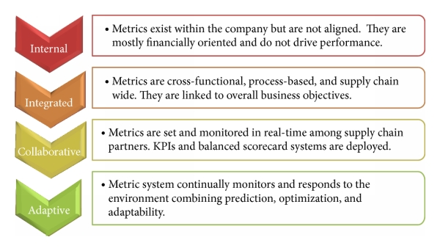
Proactive Supply Chain Performance

Slide 50
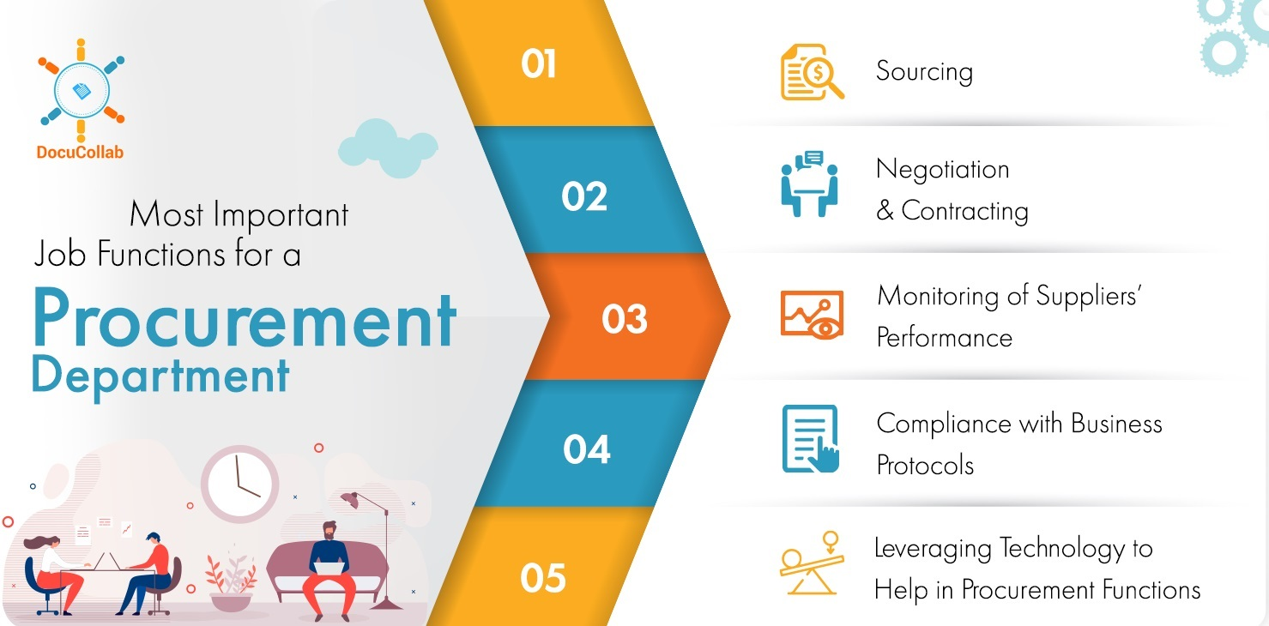
Procurement

Slide 51
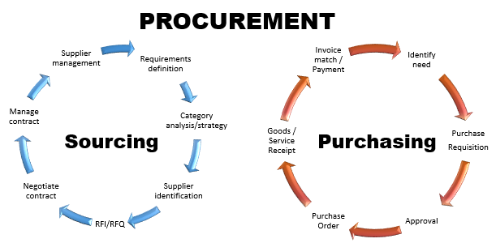

Slide 52
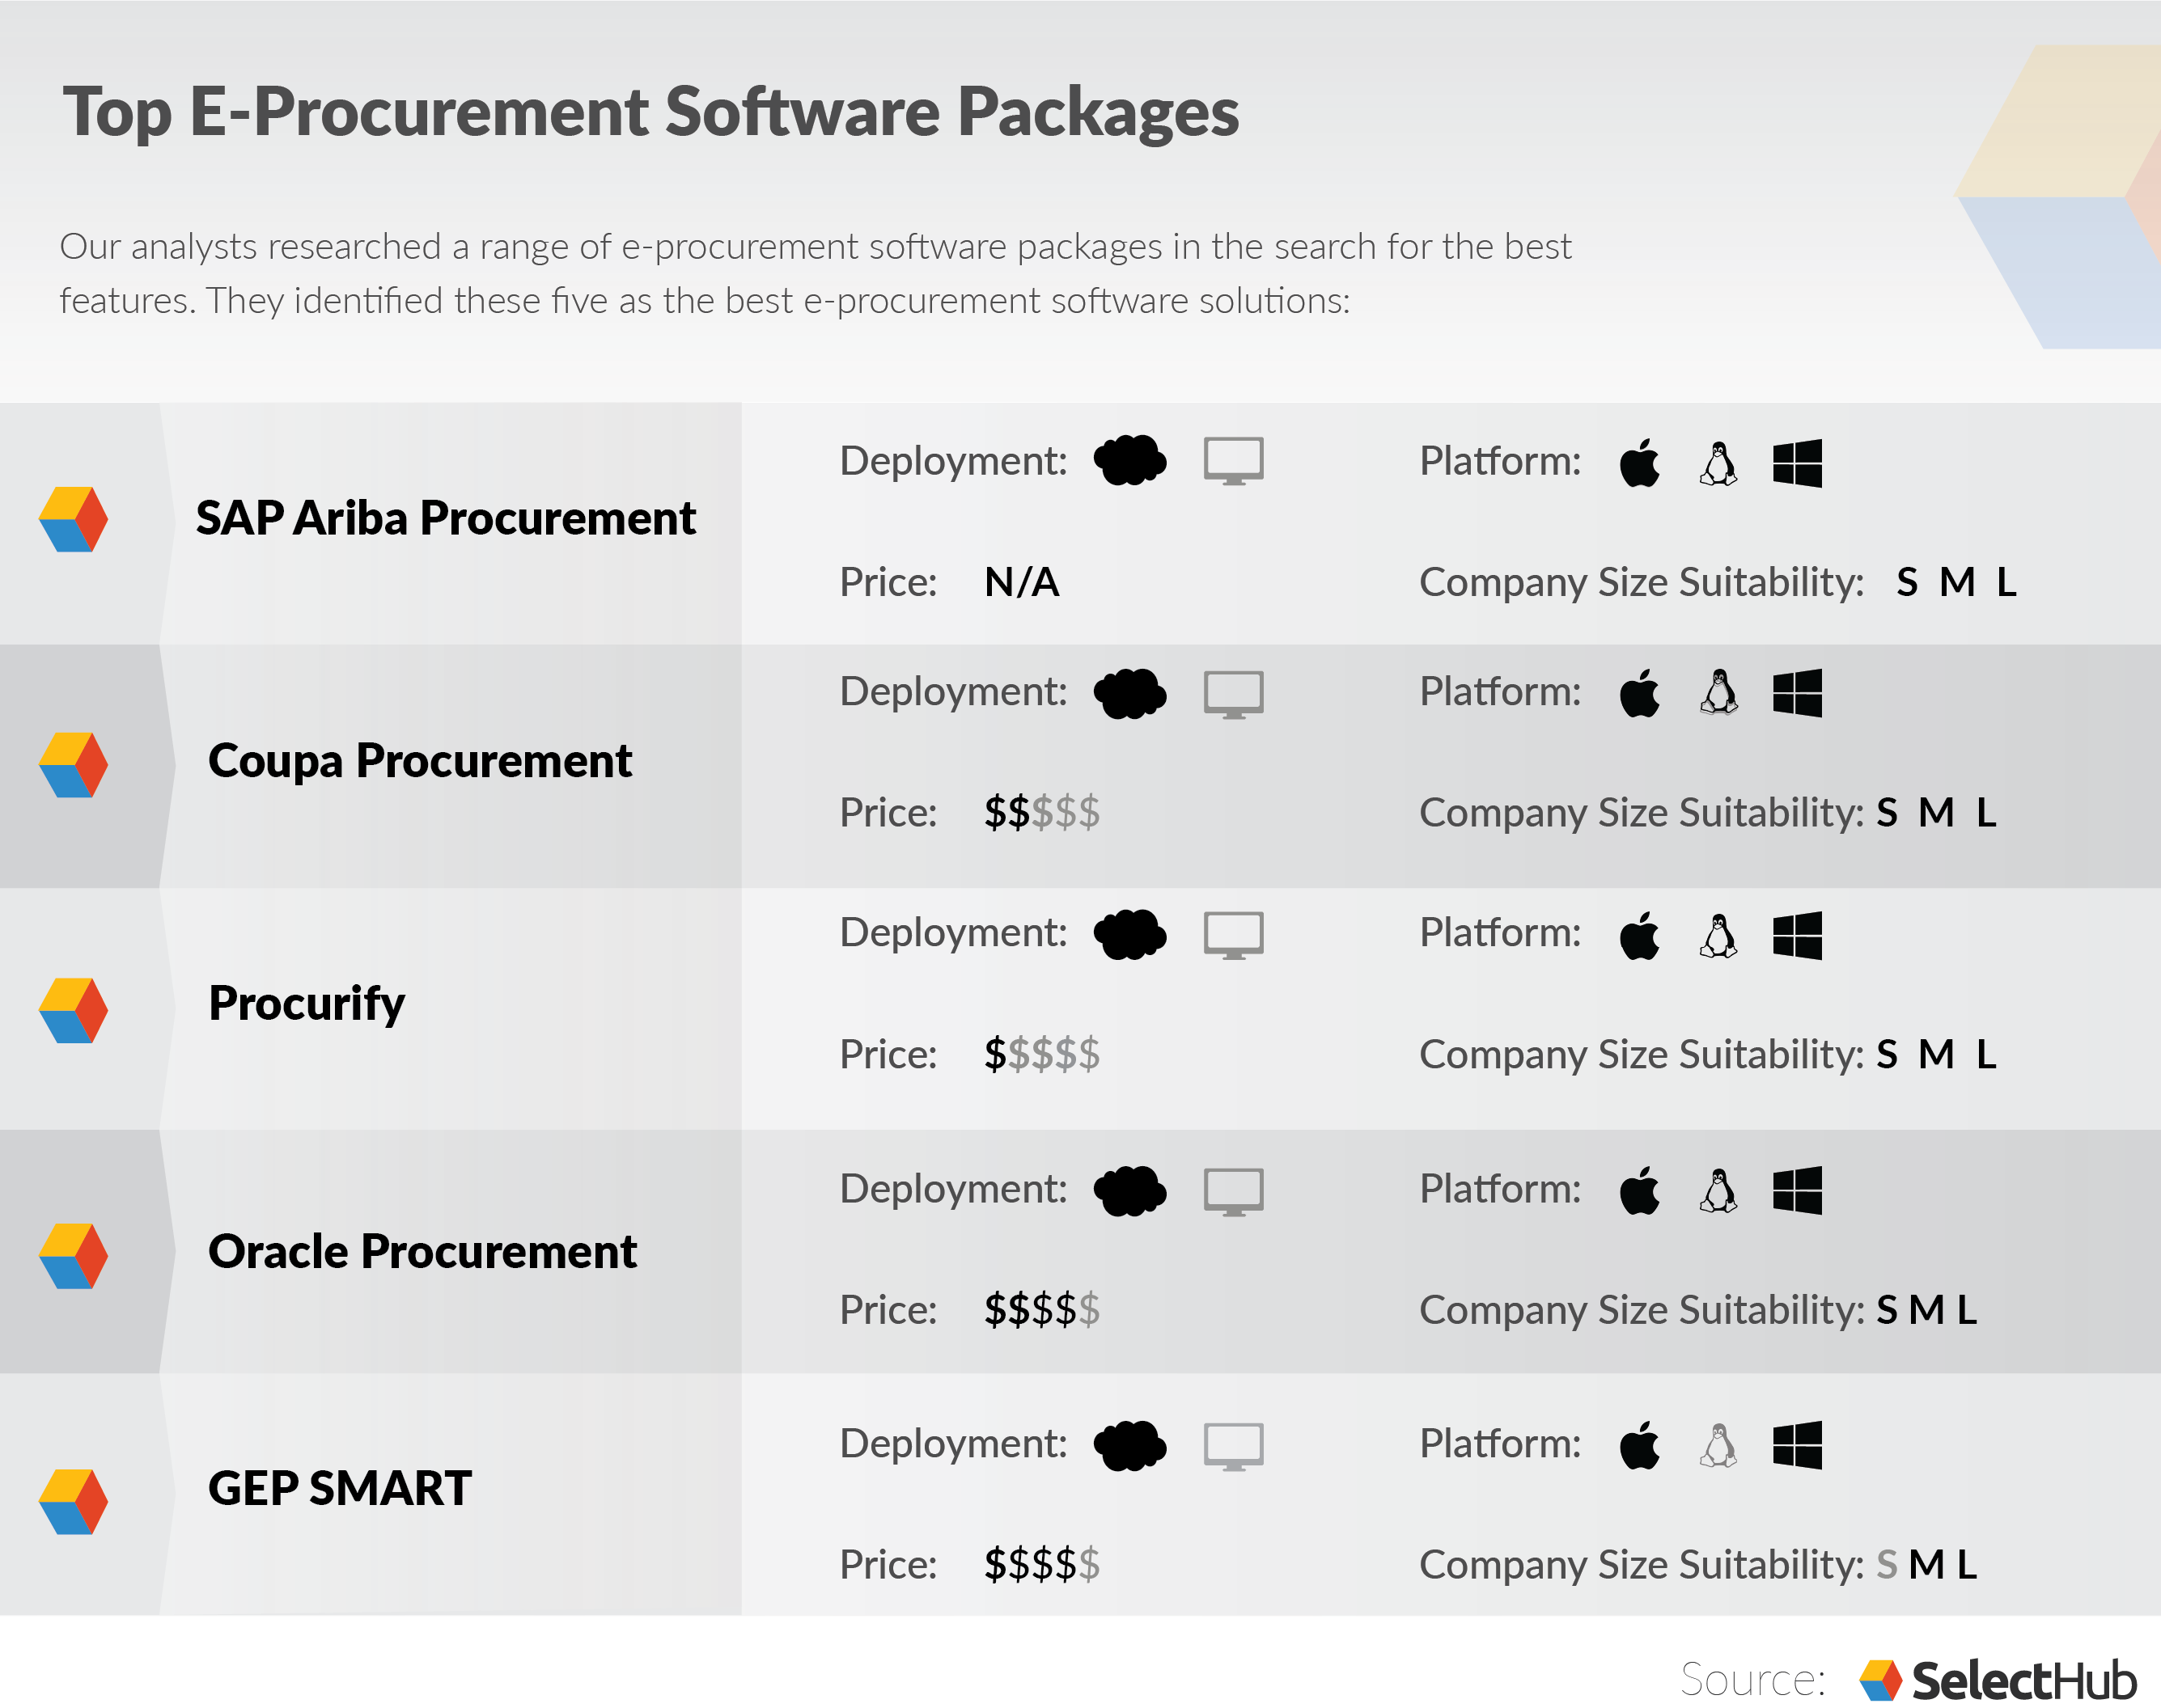
E-procurement software

Slide 53


Slide 54

Process for procurement

Slide 55


Slide 56

Strategic Sourcing

Slide 57


Slide 58


Slide 59

Inventory Models

Slide 60


Slide 61


Slide 62

Aggregate Planning

Slide 63


Slide 64


Slide 65

Approaches to aggregate planning

Slide 66


Slide 67

Resource Allocation Decisions

Slide 68


Slide 69


Slide 70


Slide 71

Value Model

Slide 72


Slide 73

Decision Tree Analysis

Slide 74

Monte-Carlo Simulation

Slide 75

Influence Diagram

Slide 76

Influence Diagram

Slide 77

Make or Buy Decision

Slide 78


Slide 79

Stages of Make/Buy Decision

Slide 80


Slide 81

Importance of Make/Buy Decision

